Slide 1
SDLC Methodologies (V-model, Waterfall, Rup, Agile
Presented by
V.A.

Slide 2
Waterfall Model
The oldest and most famous model for building a multi-level development process is the waterfall model: in it, each stage of development corresponding to the stage of the software life cycle continues the previous one

Slide 3
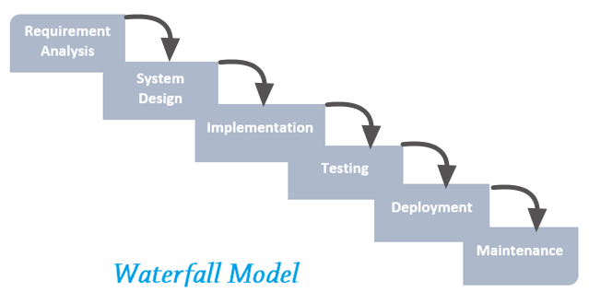
Main Phases

Slide 4
Waterfall model (Main principles)
Single execution of each phase of the project
Each phase must be completed before the next
All requirements must be identified.
At the end of each phase, a review is conducted.
Testing begins when development is complete.

Slide 5
Waterfall model (Pros)
Complete documentation of each step
Clear time and cost planning
Process transparency for the customer

Slide 6
Waterfall model (cons)
The need to approve the full amount of requirements for the system at the first stage
If it is necessary to amend the requirements later, return to the first stage and rework all the work done again.
Increase in cost of funds and time in case of need to change requirements

Slide 7
Waterfall model (cons)
High risk and uncertainty
During testing, it is difficult to fix something at a conceptual level.
Workable software only appears in the last stages

Slide 8
Waterfall Model Application
For medium and large projects, where dozens of programmers and several different project teams are involved
Projects in which requirements and boundaries are transparent and precisely known at the beginning of the project life cycle.

Slide 9
V-model
V-Model is a model for the development aimed at simplifying the understanding of the complexities associated with the development of systems

Slide 10
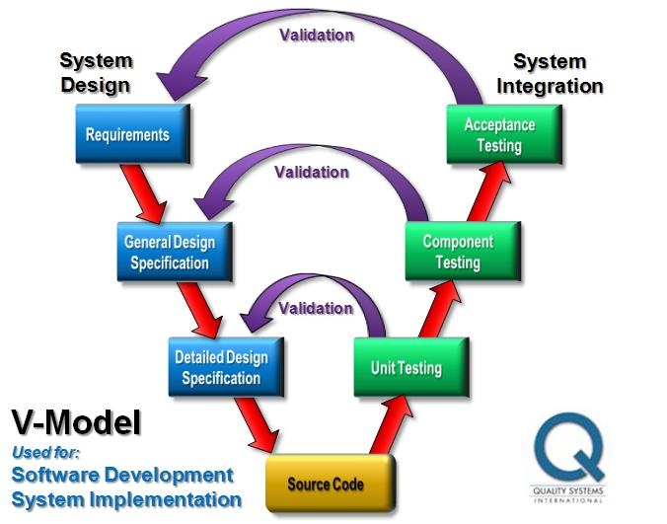
Main Phases

Slide 11
V-model (Main principles)
Makes the project more transparent and improves the quality of project control
Enhancement and Quality Assurance: Intermediate Results Can Be Checked Early
Reducing the total cost of the project
Improves the quality of communication between project participants

Slide 12
V-model (pros)
Intermediate testing
Planning, testing and verification of the system is carried out in the early stages.
Simplicity and ease of use
Bugs can be detected in the early stages.

Slide 13
V-model (cons)
Insufficient model flexibility
No work with concurrent events and the possibility of dynamic changes
Early software prototypes not produced

Slide 14
Application V-model
In projects in which time and financial restrictions exist
For tasks that involve a wider test coverage than the cascade model.

Slide 15
Agile model
It is a combination of different approaches. Based on the "agile manifest"

Slide 16
Agile Manifest
People and interaction are more important than processes and tools.
A working product is more important than comprehensive documentation
Collaboration with the customer is more important than negotiating the terms of the contract

Slide 17
Agile Manifest
Preparedness for change is more important than following the original plan.

Slide 18
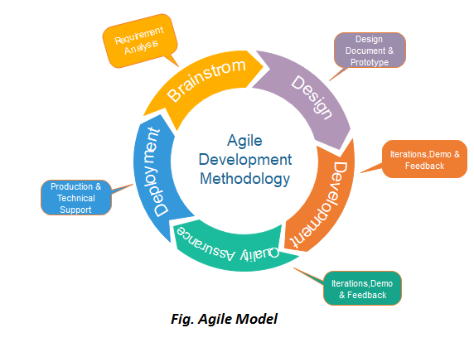
Agile model

Slide 19
Agile model (Main principles)
This type of basis is based on short daily meetings - “Scrum” and regularly repeated meetings (once a week, once every two weeks or once a month), which are called “Sprint”.

Slide 20
Agile model (pros)
Fast and continuous delivery of viable software
Face to Face Communication
Close collaboration between business analysts and programmers
Regular adaptation to changing circumstances
Possible late changes in requirements

Slide 21
Agile model (cons)
Perhaps the software will be developed forever.
Lack of long-term planning
All incoming tasks are solved in quick and simple ways.

Slide 22
Where to use AGILE
When the client is ready to regularly spend his time communicating with the team.
If you need a quick launch of the product
If there are no long-term plans
If there is no strict budget and timeline

Slide 23
RUP (Rational Unified Process)
Software Development Methodology Created by Rational Software
At the end of each iteration (ideally lasting from 2 to 6 weeks), the project team must achieve the goals planned for the given iteration, create or modify the project artifacts and get an intermediate but functional version of the final product.

Slide 24
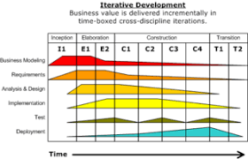
RUP

Slide 25
RUP (Main principles)
Early identification and continuous (until the end of the project) elimination of the main risks
Concentration on fulfilling customer requirements for the executable program.
Waiting for changes in requirements, design decisions and implementation during development.

Slide 26
RUP (Main principles)
Architecture implemented and tested in the early stages of the project.
Constant quality assurance at all stages of development
Work on a project in a close-knit team, in which architects play a key role.

Slide 27
RUP (Pros)
The RUP methodology allows you to cope with changes in requirements, regardless of whether they come from the client or arise during the work on the project.
RUP emphasizes the need for accurate documentation.
Integration of requirements occurs throughout the development process, and in particular in the construction phase.

Slide 28
RUP (cons)
RUP relies on the ability of experts and professionals to assign actions to specific employees, who are then required to deliver planned results in the form of artifacts.
Integration into the development process may adversely affect other more fundamental activities at the testing stages.

Slide 29
Where to use RUP
The methodology is difficult to apply in small companies and small projects.

Slide 30
Feature Comparison Chart
Model | Pros | Cons | Testing
Waterfall | Each stage has a clear verifiable result. At each point in time, the team performs one type of work Works well for small tasks. | Complete inability to adapt the project to changes in requirements Very late creation of a working product | From the middle of the project
V model | Each stage has a clear verifiable result. Attention is paid to testing from the first stage. Works well for projects with stable requirements. | Lack of flexibility and adaptability Lack of early prototypes Difficulty resolving problems missed in the early stages of the project | On transitions between stages

Slide 31
Feature Comparison Chart
Model | Pros | Cons | Testing
Agile | Maximum customer involvement A lot of work with requirements Close integration of testing and development Documentation minimization | Complexity of implementation for large projects Building complexity for large projects | At a certain moment of iteration or at any necessary moment

Slide 32
Feature Comparison Chart
Model | Pros | Cons | Testing
RUP | Comparative ease of description and visibility of models Reducing the impact of serious risks in the early stages of the project, which minimizes the cost of addressing them Organization of effective feedback of the project team with the consumer and the customer and the creation of a product that really meets his needs Focus on the most important and critical areas of the project | The inability to conduct a detailed analysis of processes A holistic understanding of the project’s capabilities and limitations has been absent for a very long time During iterations, it is necessary to discard part of the work done earlier. | Testing is possible throughout the work cycle.

